Slide 1
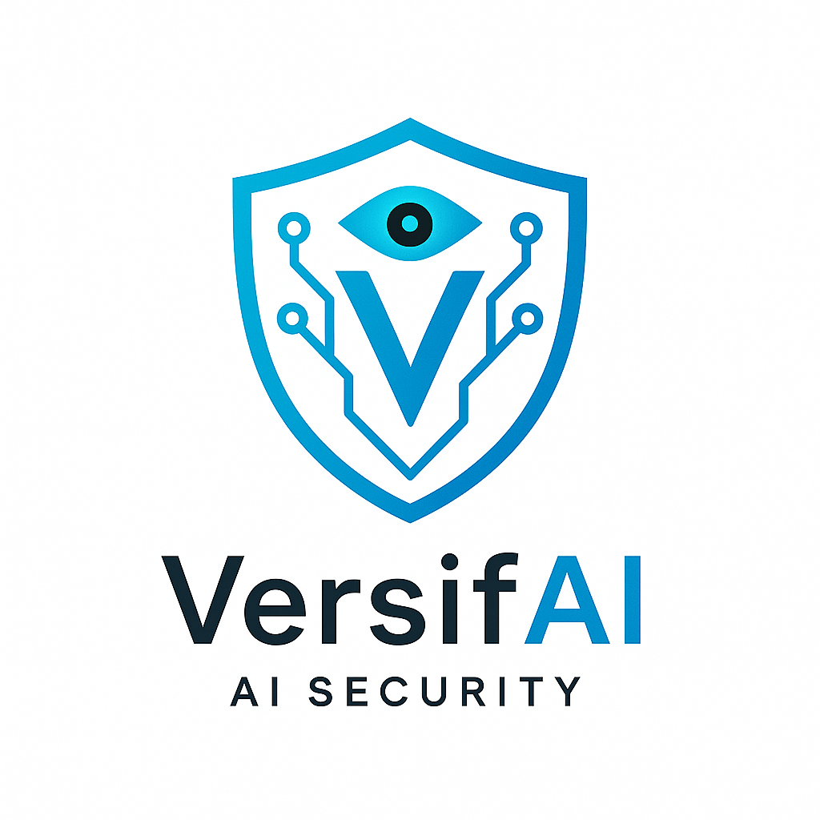

Introduction of AI Agents
Presented by: Sourour Hammoud
August 2,2025

Slide 2

Plan:
What are LLMs?
What are AI Agents?
Components of AI Agents
Cycles of AI Agents
Types of Agents
When to use AI Agents
AI Agent Frameworks
What is Agentic AI
Agentic Design Principles
Design Pattern in Agentic AI Systems
Guardrails

Slide 3


What are llmS?

Slide 4
An LLM is a type of AI model that excels at understanding and generating human language It learns by reading huge amounts of text, so it can understand how language works. Most modern LLMs use something called a Transformer [1].
TYPES OF TRANSFORMER
ENCODER
DECODER
SEQ2SEQ

Slide 5
TYPES OF ENCODER:
BERT
RoBERTa
Many popular encoder-based Transformer models such as RoBERTa, DistilBERT, and ALBERT are variants or improvements of the original BERT architecture, sharing its core design while optimizing for performance, size, or training efficiency [3].

Slide 6
TYPES OF DECODER:
GEEDY DECODING
BEAM SEARCH

Slide 7
What are AI AGENTS?

Slide 8
AI Agents are systems that enable Large Language Models(LLMs) to perform actions by extending their capabilities by giving LLMs access to tools and knowledge [3].
The concept of agents existed before the creation of LLMs (Large Language Models). The advantage of building AI Agents with LLMs is their ability to interpret human language and data [3].

Slide 9
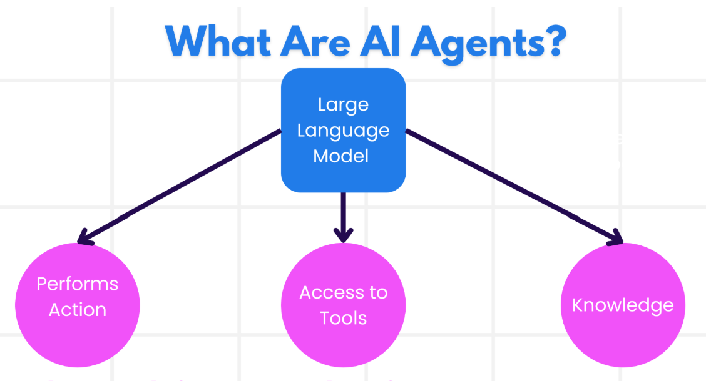

Slide 10
Components of ai agents

Slide 11

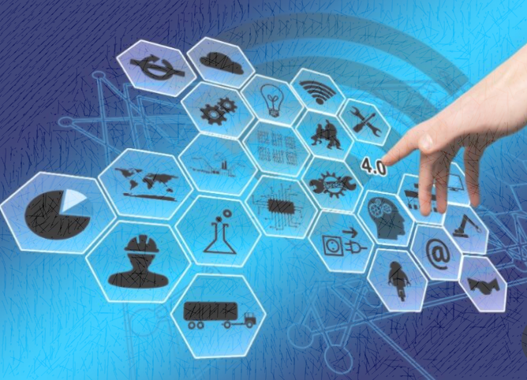
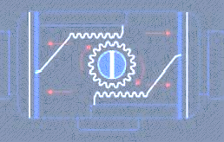
ENVIRONMENT
SENSORS
ACTUATORS

Slide 12
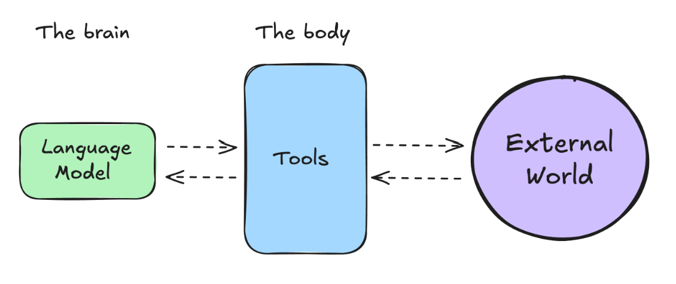

Slide 13
CYCLES OF AI AGENTS

Slide 14
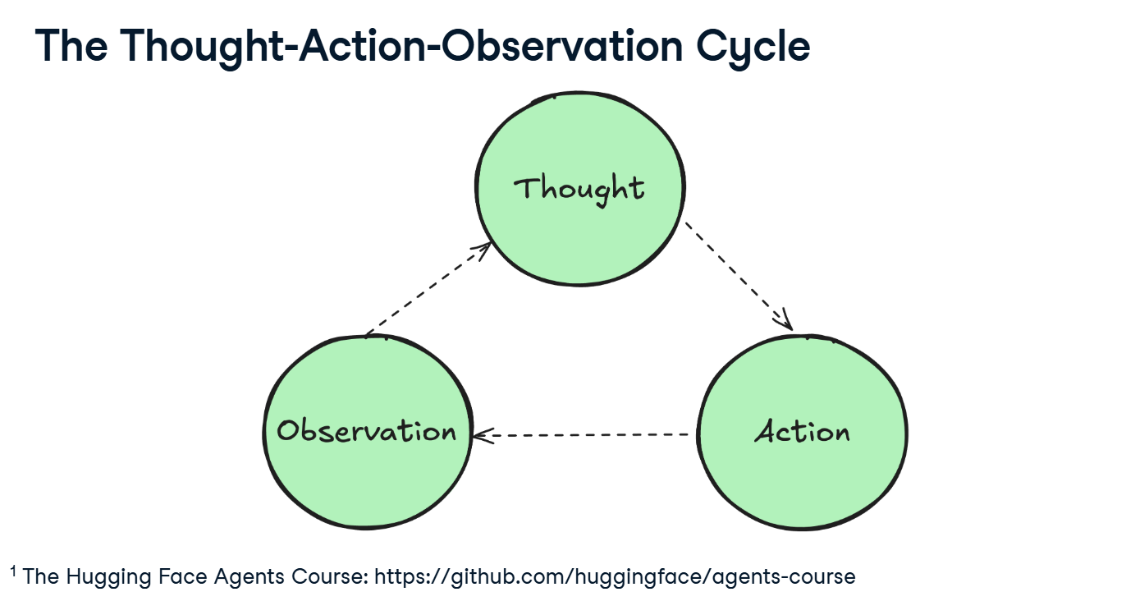

Slide 15
TYPES OF THOUGHT:
Planning
Decision Making
Problem Solving
Memory Integration
Analysis
Self Reflection
Goal Setting
Prioritization

Slide 16
TYPES OF AGENT ACTION FORMAT:
JSON File
Code Agent
Function Calling Agent
TYPES OF ACTION:
Information Gathering
Tool Usage
Environment Interaction
Communication

Slide 17
TYPES OF OBSERVATION:
System Feedback
Data Changes
Environment Data
Response Analysis
Time-based Events

Slide 18
TYPES OF AGENTS

Slide 19







SIMPLE REFLEX AGENTS
MODEL BASED REFLEX AGENTS
GOAL BASED AGENTS
UTILITY BASED AGENTS
LEARNING AGENTS
HIERARCHICAL AGENTS
MULTI AGENTS SYSTEMS(MAS)

Slide 20
LEVEL OF AGENCY:
Simple Processor: A model that generates outputs directly from inputs without planning or external interactions [4].
Router: A model that selects or routes to the most relevant operation or instruction path depending on context [4].
Tool Caller: A model that learns to invoke external tools to enhance its performance on tasks [4].
Multi Step Agent: An agent that reasons across multiple steps by combining intermediate outputs before arriving at a final answer [4].
Multi Agent: An architecture where several specialized models or agents interact to solve tasks collaboratively or competitively [4].

Slide 21
Cisco AI Agent
Webex AI Agent: A conversational AI assistant that delivers fully automated, human‑like interactions across voice and digital channels. It autonomously handles high‑volume customer inquiries, resolves issues, and smoothly escalates to human agents when needed [5].
Cisco AI Assistant for Webex Contact Center: Aimed at supporting live agents, it offers real-time features like suggested responses, transcription, call summaries, and agent Wellness analytics to boost productivity and customer satisfaction [5].

Slide 22




SINGLE AGENT:
One AI does everything, like a chatbot answering questions. It’s simpler but may struggle with complex tasks [6].
Memory
User
Agent
Agents
Tools
Multi AGENT:
Multiple AIs work together, like a team where one handles logistics and another customer service. It’s more robust but harder to coordinate [6].
User
Manager Agent

Slide 23
The differences between Single Agent and Multi Agents:
Aspect | Single Agent | Multi Agents
Complexity | Low | High
Coordination Needed | None | High
Scalability | Limited | High
Use Case | Simple Tasks | Complex Workflows
Frameworks can use | LangChain | AutoGen, LlamaIndex

Slide 24
WhEN TO USE AI AGENTS

Slide 25
Open Ended Problems
Multi Step Processes
Improvement Over Time
Multiple actions
Tool usage
Adapts behavior
Task is not clear
Learn from feedback
dynamic
hardcoded
Multi turn reasoning
Repetitive

Slide 26
AI AGENT FRAMEWORKS

Slide 27
Traditional AI Frameworks can help you integrate AI into your apps and make these apps better in the following ways:
-Personalization: AI can analyze user behavior and preferences to provide personalized recommendations, content, and experiences [3].
-Automation and Efficiency: AI can automate repetitive tasks, streamline workflows, and improve operational efficiency [3].
- Enhanced User Experience: AI can improve the overall user experience by providing intelligent features such as voice recognition, natural language processing, and predictive text [3].

Slide 28
Use Modular Components: AI Agent frameworks like Microsoft Semantic Kernel and Lang Chain give you ready-made parts like AI connectors, memory tools, and prompt templates. These help teams build smart systems quickly without starting from zero [3].
Leverage Collaborative Tools: Leverage collaboration tools means using AI tools to create agents that work together. Each agent does a different job, like finding data or making decisions. Together, they solve tasks faster and better [3].
Learn in Real-Time: AI agents can learn while working. They look at what happens, learn from mistakes, and do better next time. This helps them improve over time [3].

Slide 29
The differences between AutoGen, Semantic Kernel and Azure AI Agent Service are:
Framework | Focus | Core Concepts | Use Cases | TYPE
AutoGen | Event-driven, distributed agentic applications | Agents, Personas, Functions, Data | Code generation, data analysis tasks | Multi-agent collaboration framework
Semantic Kernel | Understanding and generating human-like text content | Agents, Modular Components, Collaboration | Natural language understanding, content generation | developer SDK
Azure AI Agent Service | Flexible models, enterprise security, Code generation, Tool calling | Modularity, Collaboration, Process Orchestration | Secure, scalable, and flexible AI agent deployment | Cloud-based AI agent management

Slide 30
What is AGENTIC AI

Slide 31
Agentic AI refers to AI systems that can act on their own, making decisions and performing tasks with little human help. Think of it like a smart assistant that can plan a trip, book flights, and adjust plans based on real-time updates, all by itself [6].
Agentic AI architecture is a cutting-edge blueprint designed to create intelligent agents that mimic human cognitive abilities, enabling them to perform tasks autonomously, make informed decisions, and adapt to changing environments. Unlike traditional AI models, which are rigid and task-specific, Agentic AI systems are designed to be more dynamic and flexible, allowing them to evolve and interact with other AI components [7].

Slide 32
KEY FRAMEWORKS PRINCIPALES:
LangChain
Tools
Agents
LLMs
Zep
Memory
AIPulgin
Tool
DuckDuck
GoSearchRun
Memory
Vector
Store
Retrieve
Memory
Conservation
Buffer
memory
Conservation
Summery
Memory
Conservation
Buffer
Window
Memory
Load
tools
Initialize
Agent
Prompt
Open
AI
Core
Message
Runnable
GPT4All
Llama
cpp
Agent
Type
GoogleSearchRun
LangChain:

Slide 33
LlamaIndex
Core
Tools
LLMs
Vector
Store
Index
Service
Context
Simple
Directory
Reader
OpenAI
Query
Engine
Tool
Anthropic
Function
Tool
Agent
ReAct
Agent
2. LlamaIndex:

Slide 34
AutoGen
Assistant
Agent
User
Proxy
Agent
GroupChat
GroupChat
Manager
3. AutoGen:

Slide 35
AGENTIC DESIGN PRINCIPLES

Slide 36



SPACE
TIME
CORE

Slide 37
DESIGN Pattern in agentic Ai systems

Slide 38
Agentic AI design patterns enhance the autonomy of large language models (LLMs) like Llama, Claude, or GPT by leveraging tool-use, decision-making, and problem-solving. This brings a structured approach for creating and managing autonomous agents in several use cases [8].

Slide 39
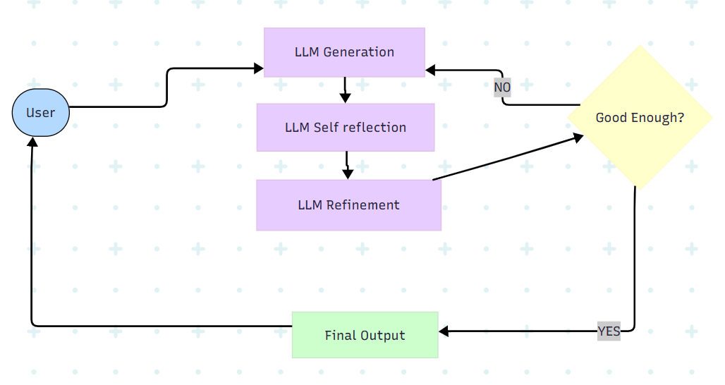
THE CORE DESIGN PATTERNS:
Reflection Pattern: The Reflection Pattern lets an AI review its own work to find mistakes and improve. It’s like an AI checking its essay for errors before submitting [6].

Slide 40
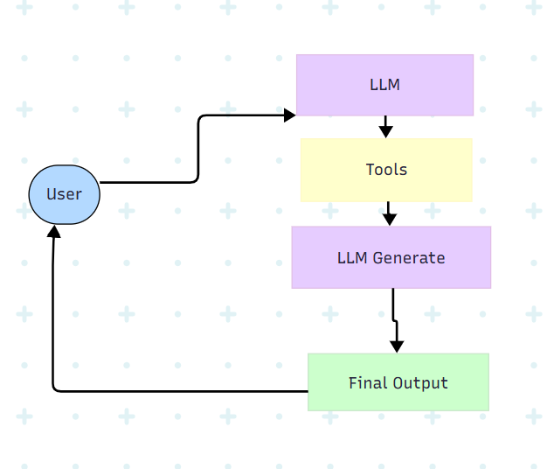
2. Tool Use Design Pattern: The Tool Use Design Pattern focuses on giving LLMs the ability to interact with external tools to achieve specific goals. Tools are code that can be executed by an agent to perform actions [3].

Slide 41
CASES TO USE THESE TOOLS
Dynamic Information Retrieval
Code Execution and Interpretation
Workflow Automation
Content Generation and Editing
Customer Support

Slide 42
Key Elements of the Tool Use Design Pattern:
Function/Tool Schemas: describe each tools, its name, what it does, input needs and what it returns [3].
Function Execution Logic: Decides when and how to use tools based on the user’s message and the context of the conversation [3].
Message Handling System: Manages the flow between the user, the AI, tool requests and tool responses [3].
Tool Integration Framework: Connect the Agent to actual tools [3].
Error Handling and Validation: Catches problems like missing or incorrect input, failed tool calls and ensure responses make sense [3].
State Management: Tracks conversation context, previous tool interactions, and persistent data to ensure consistency across multi-turn interactions [3].

Slide 43
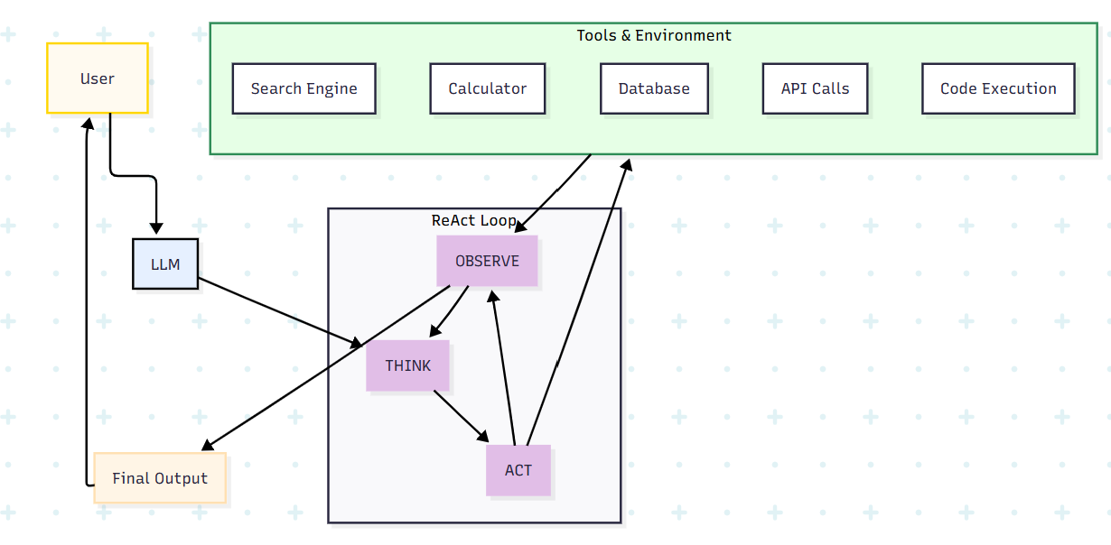
3. ReAct Pattern: The ReAct Pattern, or “Reason and Act,” means the AI thinks through a problem step by step and then takes actions, like using tools, based on that thinking. It’s like planning and doing at the same time [6].

Slide 44
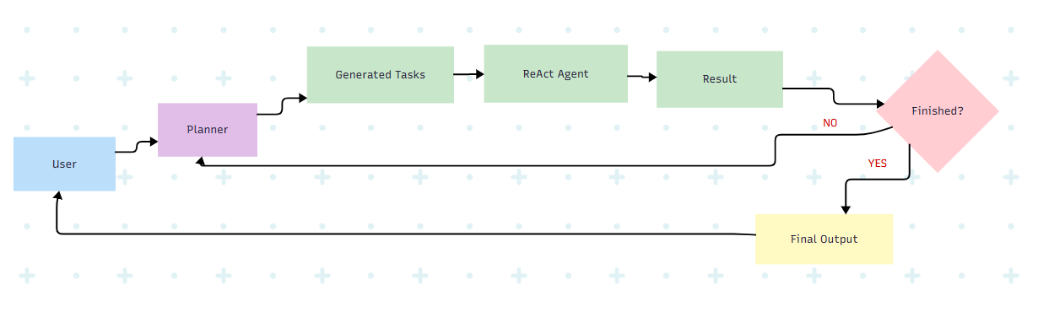
4. Planning Pattern: The Planning Pattern means the AI breaks down big tasks into smaller steps and makes a plan to tackle them, like outlining a project before starting [6].

Slide 45
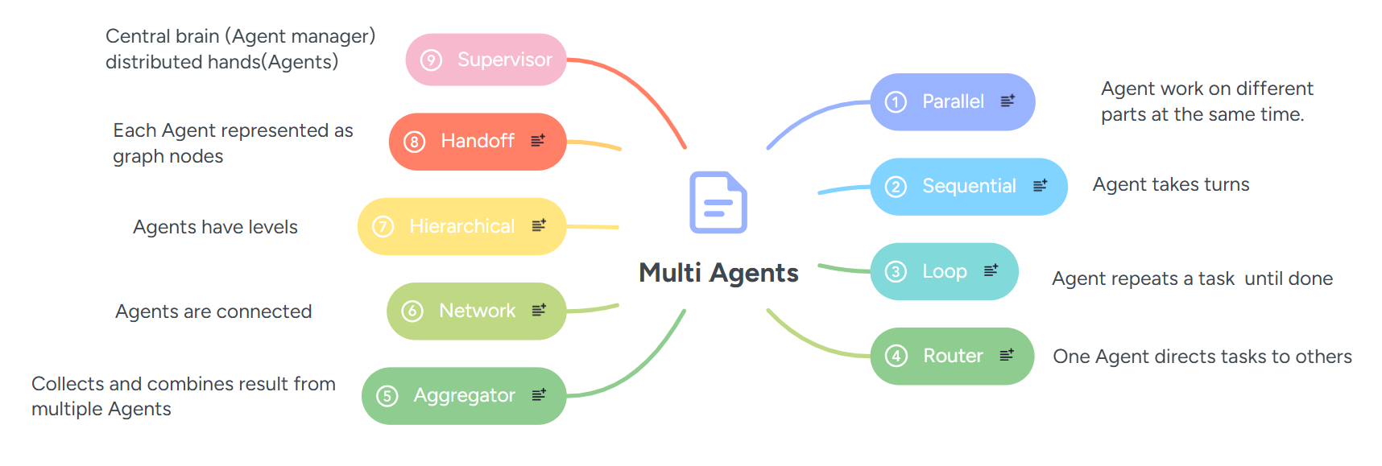
5. Multi Agent Pattern: Agentic AI Multi-Agent Pattern for building collaborative, efficient AI systems. Learn its benefits, frameworks & real-world applications [9].
For multi-agent setups, there are patterns like:

Slide 46
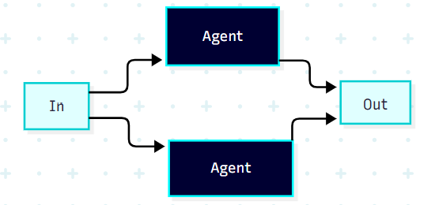
5.1. Parallel: Agents work on different parts at the same time, like processing text and images together. Each agent operates on the input text independently, requiring no inter-agent communication during execution [10].
Use case: Summarizing, translating, and analyzing sentiment are common NLP tasks that benefit from parallel processing, especially with larger texts [10].

Slide 47
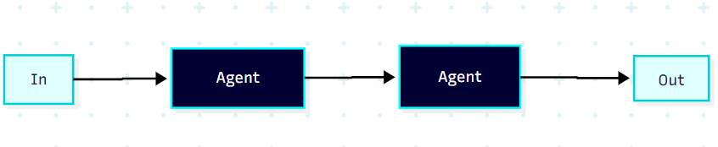
5.2. Sequential: Agents take turns, like cleaning data then analyzing it. Agents run in order If any agent rejects, the loop breaks, skipping remaining agents. Results are stored in a list, but the Proposal object carries the state between agents [10].
Use case: This pattern is ideal for creating deterministic workflows where each agent contributes to a specific sub-task in a defined order. A practical example is a marketing copy generation pipeline: a Concept Extractor Agent analyzes the product description, a Writer Agent crafts the marketing copy, a Format & Proof Agent refines it, and finally, a User Agent presents the polished copy to the user [16].

Slide 48
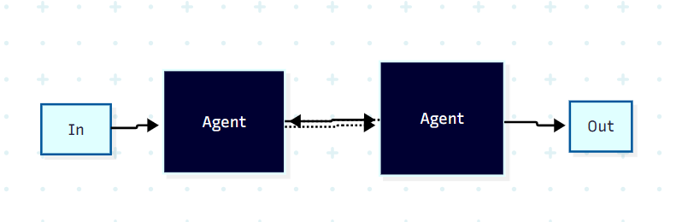
5.3. Loop: Agents operate in iterative cycles, continuously improving their outputs based on feedback from other agent(s) [10].
Use case: This pattern is crucial for systems that require continuous adaptation, learning, or self-optimization. It is evident in autonomous research systems where LLMs iteratively use tools in a loop (Think → Act → Observe → Respond) to handle multi-step tasks, refine results, and adapt to new information. Examples include adaptive control systems, continuous learning agents, and self-optimizing processes [13].

Slide 49
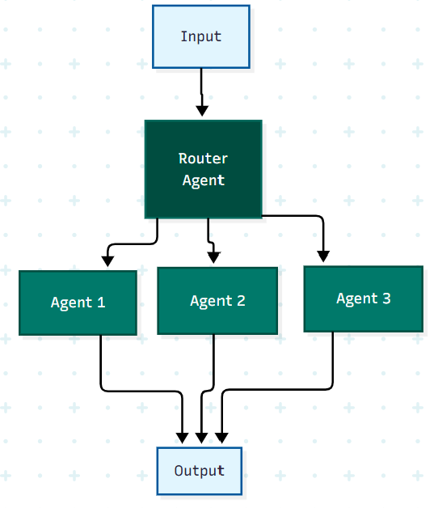
5.4. Router: One agent directs tasks to others, like routing customer queries. The router_agent determines the ticket category, and the route_ticket function directs the workflow to the appropriate node using add_conditional_edges [10].
Use case: This pattern is effective when incoming requests cover a wide range of topics and complexities, provided they can be reliably categorized. Its primary goal is to ensure accurate responses by routing requests to the most suitable processing unit. Applications include customer service systems that route inquiries to specific departments or resource-efficient systems that direct simple questions to smaller, less costly LLMs and complex questions to more powerful reasoning models [15].

Slide 50
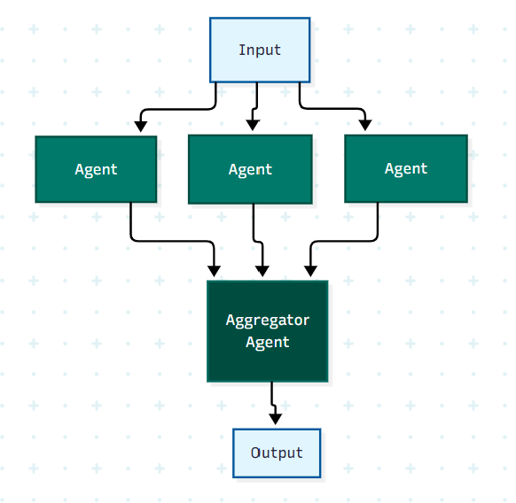
5.5. Aggregator: Runs multiple AI agents simultaneously on the same task. This approach allows each agent to provide independent analysis or processing from its unique perspective or specialization [11].
Use case: In a multi-agent debate system, an Aggregator Agent collects answers from multiple solver agents and synthesizes them into a single final solution [14].

Slide 51
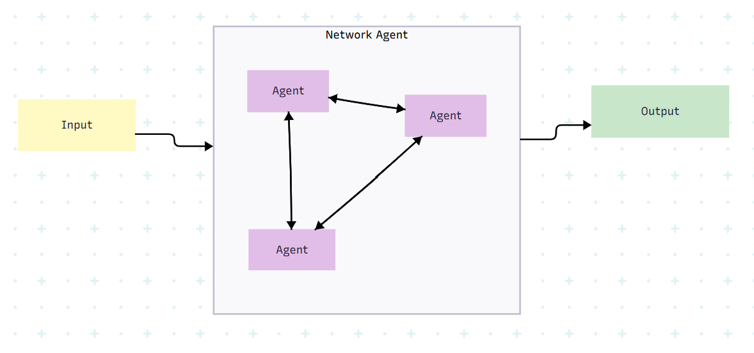
5.6. Network :Agents connected in a network topology for communication [10].
Use case: This pattern is best suited for scenarios that require highly flexible and dynamic communication, where any agent might need to interact with any other agent to achieve a goal. Examples include brainstorming sessions, open-ended collaborative problem-solving environments, or decentralized systems where information flow is not restricted to predefined paths [12].

Slide 52
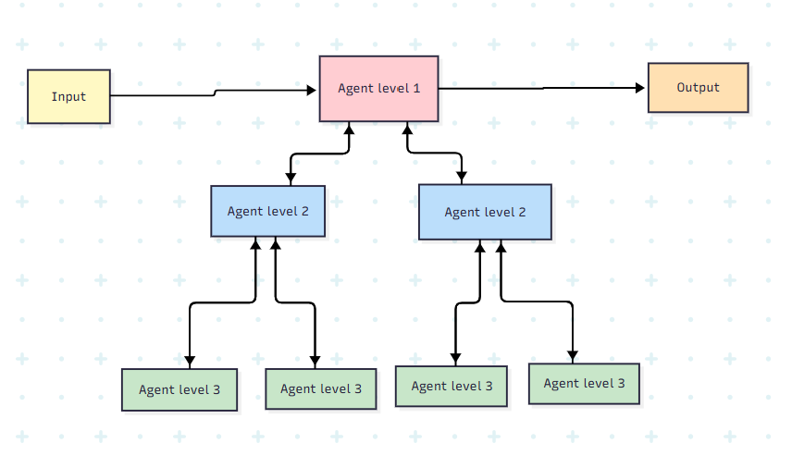
5.7. Hierarchical: Agents have levels, like executives giving goals to managers. Agents are organized in a tree-like structure, with higher-level agents (supervisor agents) managing lower-level ones. Clear division of roles and responsibilities among agents at different levels [10].
Use case: This pattern is suitable for large-scale, complex problems that can be naturally decomposed into independent sub-problems, each managed by a specialized team or supervisor. For instance, in a large organization, different departments (each with its own supervisor and team) might handle specific aspects of a complex business process, with higher-level agents coordinating across departments [12].

Slide 53
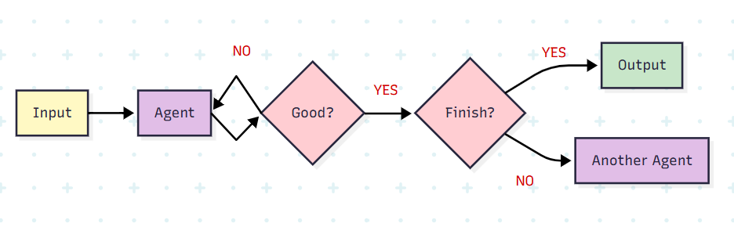
5.8. Handoff: In multi-agent architectures, agents can be represented as graph nodes. Each agent node executes its step(s) and decides whether to finish execution or route to another agent, including potentially routing to itself .A common pattern in multi-agent interactions is handoffs, where one agent hands off control to another [10].
Use case: This pattern is commonly used in customer service scenarios. For instance, a Triage Agent might initially interact with a customer, understand the nature of their request and then hand off the conversation to a specialized Refund Agent, Sales Agent, or even a Human Agent if the request is complex [14].

Slide 54
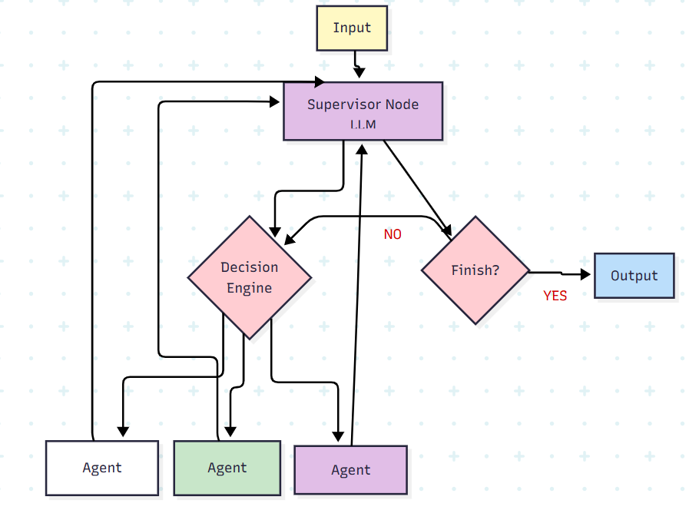
5.9. Supervisor: In this architecture, we define agents as nodes and add a supervisor node (LLM) that decides which agent nodes should be called next. We use Command to route execution to the appropriate agent node based on supervisor's decision. This architecture also lends itself well to running multiple agents in parallel or using map-reduce pattern [10].
Use case: This pattern is ideal for orchestrating complex tasks that can be broken down into smaller, manageable sub-tasks. The supervisor acts as a central coordinator, delegating responsibilities to specialized sub-agents. An example could be a project management system where a main agent assigns different parts of a project (e.g., research, writing, editing) to specialized sub-agents [12].

Slide 55
GUARDRAILS

Slide 56
Tool Guardrails
Input Guardrails
Tools
External World
User
Prompt
Model
Output Guardrails
Response

Slide 57
REFERENCE:
https://huggingface.co/learn/agents-course/en/unit0/introduction [1]
https://arxiv.org/abs/1810.04805 [2]
https://microsoft.github.io/ai-agents-for-beginners/01-intro-to-ai-agents/ [3]
https://arxiv.org/abs/2302.04761 [4]
https://newsroom.cisco.com/c/r/newsroom/en/us/a/y2025/m03/cisco-paves-the-way-with-agentic-ai-collaboration.html [5]
https://medium.com/@anil.jain.baba/agentic-ai-architectures-and-design-patterns-288ac589179a [6]
https://markovate.com/blog/agentic-ai-architecture/[7]
What Is Agentic AI? | NVIDIA Blog [8]
https://www.uipath.com/ai/agentic-ai [9]
https://medium.com/@vipra_singh/ai-agents-multi-agent-architectures-part-7-0f0e185bb083 [10]
https://medium.com/@edoardo.schepis/patterns-for-democratic-multi-agent-ai-voting-based-council-part-2-implementation-2992c3e7c2be [11]
https://medium.com/@princekrampah/multi-agent-architecture-in-multi-agent-systems-multi-agent-system-design-patterns-langgraph-b92e934bf843 [12]
https://www.anthropic.com/engineering/built-multi-agent-research-system [13]
https://microsoft.github.io/autogen/stable//user-guide/core-user-guide/design-patterns/handoffs.html [14]
https://medium.com/mongodb/here-are-7-design-patterns-for-agentic-systems-you-need-to-know-d74a4b5835a5 [15]
https://microsoft.github.io/autogen/stable//user-guide/core-user-guide/design-patterns/sequential-workflow.html [16]

Slide 58
Thank You!

